Slide 1
Transactions
Transaction Concept
Transaction State
Implementation of Atomicity and Durability
Concurrent Executions
Serializability
Recoverability
Implementation of Isolation
Transaction Definition in SQL
Testing for Serializability.

Slide 2
Transaction Concept
A transaction is a unit of program execution that accesses and possibly updates various data items.
A transaction must see a consistent database.
During transaction execution the database may be inconsistent.
When the transaction is committed, the database must be consistent.
Two main issues to deal with:
  Failures of various kinds, such as hardware failures and system crashes
  Concurrent execution of multiple transactions

Slide 3
ACID Properties
To preserve integrity of data, the database system must ensure:
Atomicity. Either all operations of the transaction are properly reflected in the database or none are.
Consistency. The database must be in a consistent state. Execution of a transaction in isolation preserves the consistency of the database.
Isolation. Although multiple transactions may execute concurrently, each transaction must be unaware of other concurrently executing transactions. Intermediate transaction results must be hidden from other concurrently executed transactions.
  That is, for every pair of transactions T_{i} and T_{j}, it appears to T_{i} that either T_{j}, finished execution before T_{i} started, or T_{j} started execution after T_{i} finished.
Durability. After a transaction completes successfully, the changes it has made to the database persist, even if there are system failures.

Slide 4
Example of Fund Transfer
Transaction to transfer $50 from account A to account B:
  1. read(A)
  2. A := A – 50
  3. write(A)
  4. read(B)
  5. B := B + 50
  6. write(B)
Consistency requirement – the sum of A and B is unchanged by the execution of the transaction.
Atomicity requirement — if the transaction fails after step 3 and before step 6, the system should ensure that its updates are not reflected in the database, else an inconsistency will result.

Slide 5
Example of Fund Transfer (Cont.)
Durability requirement — once the user has been notified that the transaction has completed (i.e., the transfer of the $50 has taken place), the updates to the database by the transaction must persist despite failures.
Isolation requirement — if between steps 3 and 6, another transaction is allowed to access the partially updated database, it will see an inconsistent database
(the sum A + B will be less than it should be).
Can be ensured trivially by running transactions serially, that is one after the other. However, executing multiple transactions concurrently has significant benefits, as we will see.

Slide 6
Transaction State
Active, the initial state; the transaction stays in this state while it is executing
Partially committed, after the final statement has been executed.
Failed, after the discovery that normal execution can no longer proceed.
Aborted, after the transaction has been rolled back and the database restored to its state prior to the start of the transaction. Two options after it has been aborted:
  restart the transaction – only if no internal logical error
  kill the transaction
Committed, after successful completion.

Slide 7

Transaction State (Cont.)

Slide 8
Implementation of Atomicity and Durability
The recovery-management component of a database system implements the support for atomicity and durability.
The shadow-database scheme:
  assume that only one transaction is active at a time.
  a pointer called db_pointer always points to the current consistent copy of the database.
  all updates are made on a shadow copy of the database, and db_pointer is made to point to the updated shadow copy only after the transaction reaches partial commit and all updated pages have been flushed to disk.
  in case transaction fails, old consistent copy pointed to by db_pointer can be used, and the shadow copy can be deleted.

Slide 9
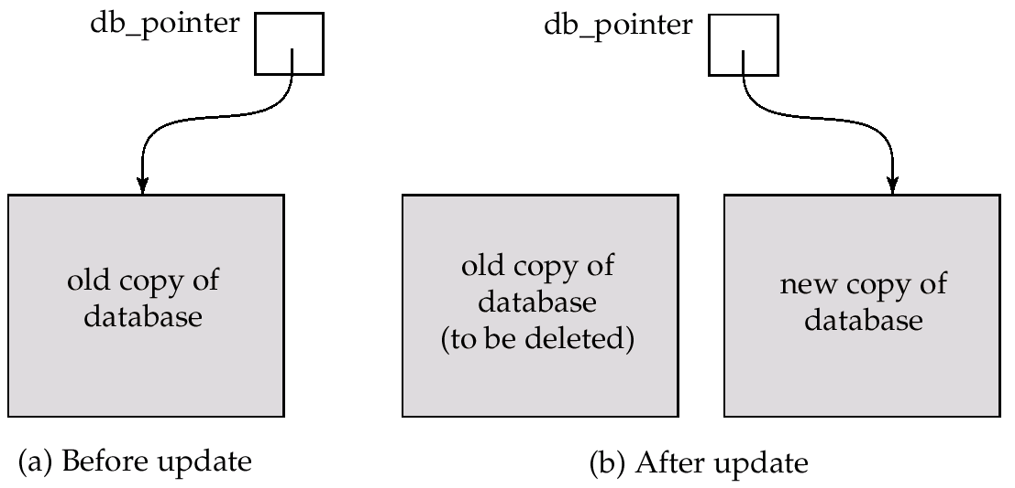
Implementation of Atomicity and Durability (Cont.)
The shadow-database scheme:
Assumes disks to not fail
Useful for text editors, but extremely inefficient for large databases: executing a single transaction requires copying the entire database. Will see better schemes later.

Slide 10
Concurrent Executions
Multiple transactions are allowed to run concurrently in the system. Advantages are:
  increased processor and disk utilization, leading to better transaction throughput: one transaction can be using the CPU while another is reading from or writing to the disk
  reduced average response time for transactions: short transactions need not wait behind long ones.
Concurrency control schemes – mechanisms to achieve isolation, i.e., to control the interaction among the concurrent transactions in order to prevent them from destroying the consistency of the database

Slide 11
Schedules
Schedules – sequences that indicate the chronological order in which instructions of concurrent transactions are executed
  a schedule for a set of transactions must consist of all instructions of those transactions
  must preserve the order in which the instructions appear in each individual transaction.

Slide 12

Example Schedules
Let T₁ transfer $50 from A to B, and T₂ transfer 10% of the balance from A to B. The following is a serial schedule (Schedule 1 in the text), in which T₁ is followed by T₂.

Slide 13

Example Schedule (Cont.)
Let T₁ and T₂ be the transactions defined previously. The following schedule (Schedule 2 in the text) is not a serial schedule, but it is equivalent to Schedule 1.
In both Schedule 1 and 3, the sum A + B is preserved.

Slide 14

Example Schedules (Cont.)
The following concurrent schedule (Schedule 4 in the text) does not preserve the value of the the sum A + B.

Slide 15
Serializability
Basic Assumption – Each transaction preserves database consistency.
Thus serial execution of a set of transactions preserves database consistency.
A (possibly concurrent) schedule is serializable if it is equivalent to a serial schedule. Different forms of schedule equivalence give rise to the notions of:
  1. conflict serializability
  2. view serializability
We ignore operations other than read and write instructions, and we assume that transactions may perform arbitrary computations on data in local buffers in between reads and writes. Our simplified schedules consist of only read and write instructions.

Slide 16
Conflict Serializability
Conflict serializability defines two instructions of two different transactions accessing the same data item to perform a read/write operation.
It deals with detecting the instructions that are conflicting in any way and specifying the order in which the instructions should execute in case there is any conflict.
A conflict serializability arises when one of the instruction is a write operation.

Slide 17
Conflict Serializability
Instructions l_{i} and l_{j} of transactions T_{i} and T_{j} respectively, conflict if and only if there exists some item Q accessed by both l_{i} and l_{j}, and at least one of these instructions wrote Q.
1. l_{i} = read(Q), l_{j} = read(Q). l_{i} and l_{j} don’t conflict.
2. l_{i} = read(Q), l_{j} = write(Q). They conflict.
3. l_{i} = write(Q), l_{j} = read(Q). They conflict
4. l_{i} = write(Q), l_{j} = write(Q). They conflict
Intuitively, a conflict between l_{i} and l_{j} forces a (logical) temporal order between them. If l_{i} and l_{j} are consecutive in a schedule and they do not conflict, their results would remain the same even if they had been interchanged in the schedule.

Slide 18
Conflict Serializability (Cont.)
If a schedule S can be transformed into a schedule S´ by a series of swaps of non-conflicting instructions, we say that S and S´ are conflict equivalent.
We say that a schedule S is conflict serializable if it is conflict equivalent to a serial schedule
Example of a schedule that is not conflict serializable:
T₃ T₄
read(Q)
write(Q)
write(Q)
We are unable to swap instructions in the above schedule to obtain either the serial schedule < T₃, T₄ >, or the serial schedule < T₄, T₃ >.

Slide 19

Conflict Serializability (Cont.)
Schedule 3 below can be transformed into Schedule 1, a serial schedule where T₂ follows T₁, by series of swaps of non-conflicting instructions. Therefore Schedule 3 is conflict serializable.

Slide 20
The following rules are important in Conflict Serializability,
1. If two transactions are both read operation, then they are not in conflict.
2. If one transaction wants to perform a read operation and other transaction wants to perform a write operation, then they are in conflict and cannot be swapped.
3. If both the transactions are for write operation, then they are in conflict, but can be allowed to take place in any order, because the transactions do not read the value updated by each other.

Slide 21
View serializability is the another type of serializability.
It can be derived by creating another schedule out of an existing schedule and involves the same set of transactions.
Example : Let us assume two transactions T1 and T2 that are being serialized to create two different schedules SH1 and SH2, where T1 and T2 want to access the same data item. Now there can be three scenarios
1. If in SH1, T1 reads the initial value of data item, then in SH2 , T1 should read the initial value of that same data item.
2. If in SH2, T1 writes a value in the data item which is read by T2, then in SH2, T1 should write the value in the data item before T2 reads it.
3. If in SH1, T1 performs the final write operation on that data item, then in SH2, T1 should perform the final write operation on that data item.
If a concurrent schedule is view equivalent to a serial schedule of same transaction then it is said to be View serializable.

Slide 22
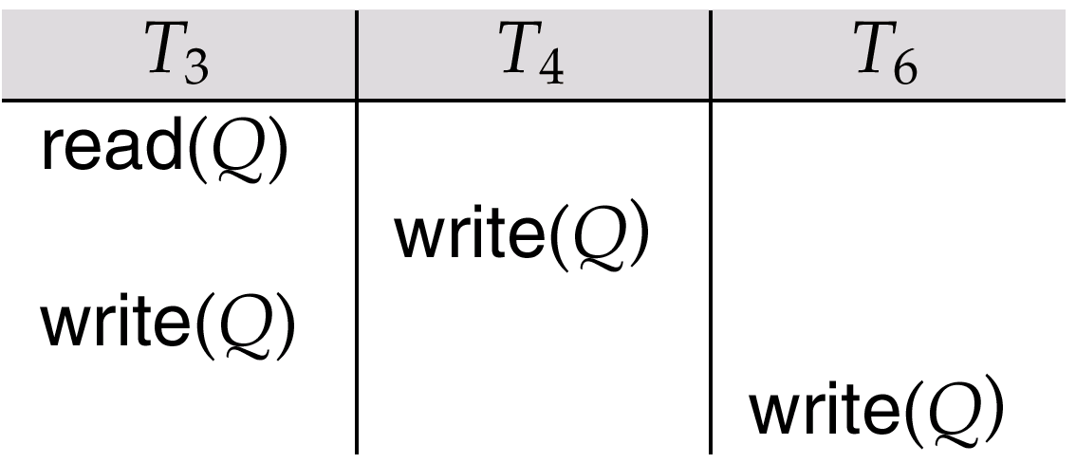
View Serializability
A schedule S is view serializable it is view equivalent to a serial schedule.
Every conflict serializable schedule is also view serializable.
Schedule 9 (from text) — a schedule which is view-serializable but not conflict serializable.
Every view serializable schedule that is not conflict
serializable has blind writes.

Slide 23
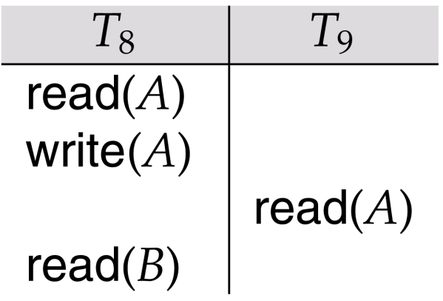
Recoverability
Need to address the effect of transaction failures on concurrently
running transactions.
Recoverable schedule — if a transaction T_{j} reads a data items previously written by a transaction T_{i} , the commit operation of T_{i} appears before the commit operation of T_{j}.
The following schedule (Schedule 11) is not recoverable if T₉ commits immediately after the read

Slide 24
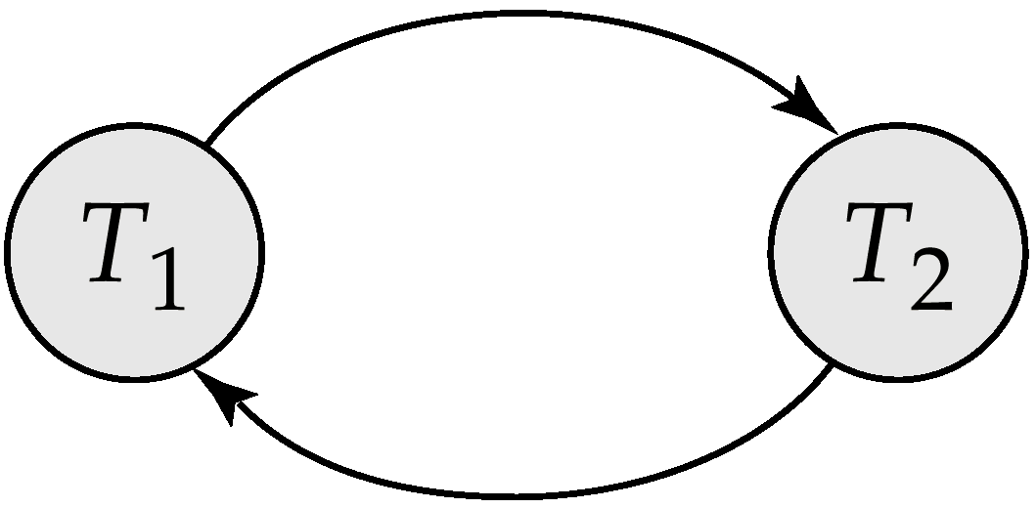
Testing for Serializability
Consider some schedule of a set of transactions T₁, T₂, ..., T_{n}
Precedence graph — a direct graph where the vertices are the transactions (names).
We draw an arc from T_{i} to T_{j} if the two transaction conflict, and T_{i} accessed the data item on which the conflict arose earlier.
We may label the arc by the item that was accessed.
Example 1
x
y

Slide 25
Example Schedule (Schedule A)
T₁ T₂ T₃ T₄ T₅
read(X)
read(Y)
read(Z)
read(V)
read(W)
read(W)
read(Y)
write(Y)
write(Z)
read(U)
read(Y)
write(Y)
read(Z)
write(Z)
read(U)
write(U)

Slide 26
Precedence Graph for Schedule A
T₁
T₂
T₄
T₃

Slide 27
Test for Conflict Serializability
A schedule is conflict serializable if and only if its precedence graph is acyclic.
Cycle-detection algorithms exist which take order n² time, where n is the number of vertices in the graph. (Better algorithms take order n + e where e is the number of edges.)
If precedence graph is acyclic, the serializability order can be obtained by a topological sorting of the graph. This is a linear order consistent with the partial order of the graph.
For example, a serializability order for Schedule A would be
T₅ → T₁ → T₃ → T₂ → T₄ .

Slide 28
Test for View Serializability
The precedence graph test for conflict serializability must be modified to apply to a test for view serializability.
The problem of checking if a schedule is view serializable falls in the class of NP-complete problems. Thus existence of an efficient algorithm is unlikely.
However practical algorithms that just check some sufficient conditions for view serializability can still be used.

Slide 29
Concurrency Control vs. Serializability Tests
Testing a schedule for serializability after it has executed is a little too late!
Goal – to develop concurrency control protocols that will assure serializability. They will generally not examine the precedence graph as it is being created; instead a protocol will impose a discipline that avoids nonseralizable schedules.
Will study such protocols in Chapter 16.
Tests for serializability help understand why a concurrency control protocol is correct.

Slide 30
End of Chapter

Slide 31
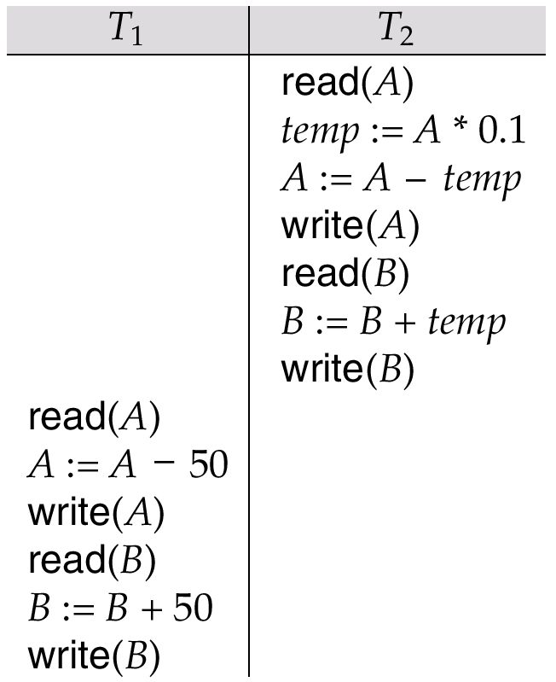
Schedule 2 -- A Serial Schedule in Which
T₂ is Followed by T₁

Slide 32
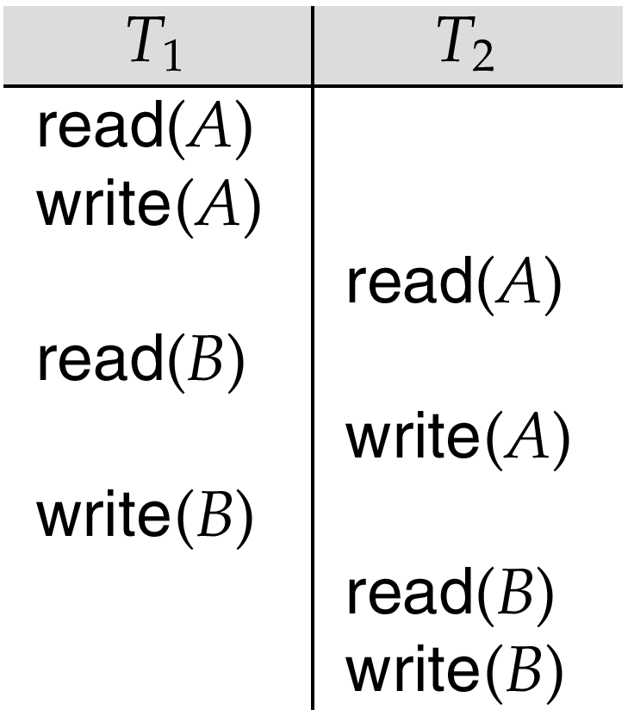
Schedule 5 -- Schedule 3 After Swapping A Pair of Instructions

Slide 33
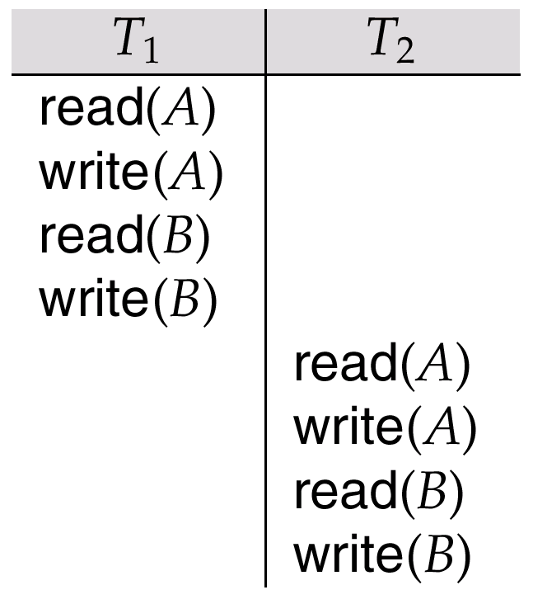
Schedule 6 -- A Serial Schedule That is Equivalent to Schedule 3

Slide 34

Schedule 7

Slide 35
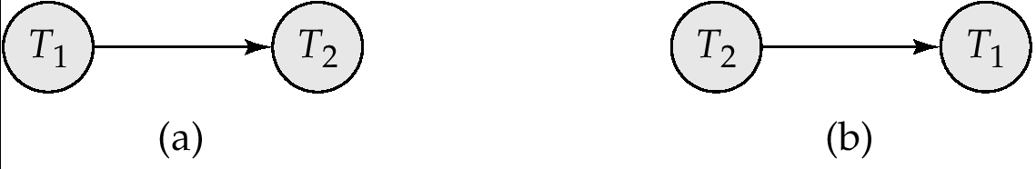
Precedence Graph for
(a) Schedule 1 and (b) Schedule 2

Slide 36
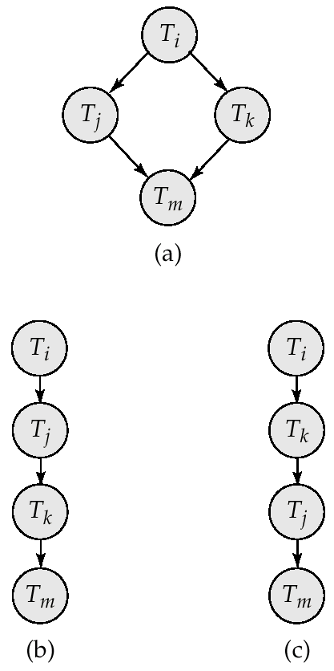
Illustration of Topological Sorting

Slide 37
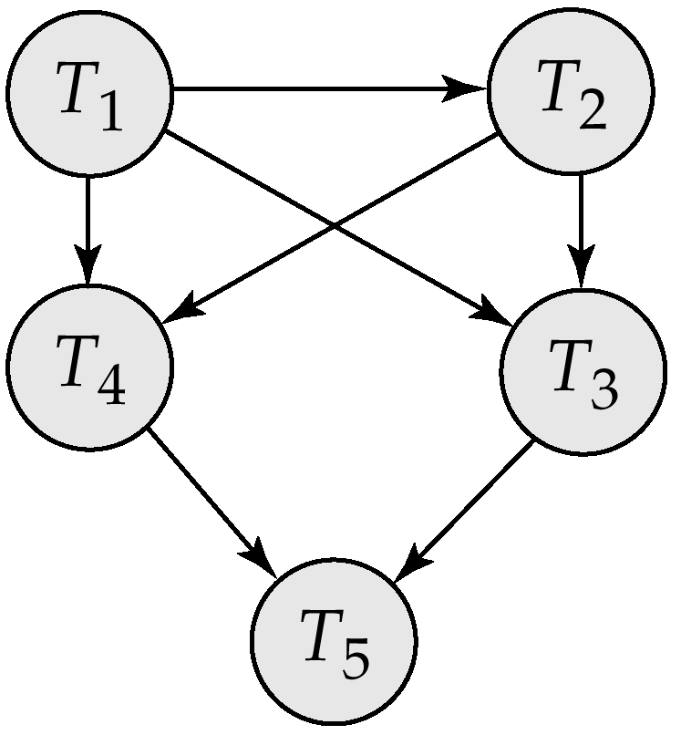
Precedence Graph

Slide 38
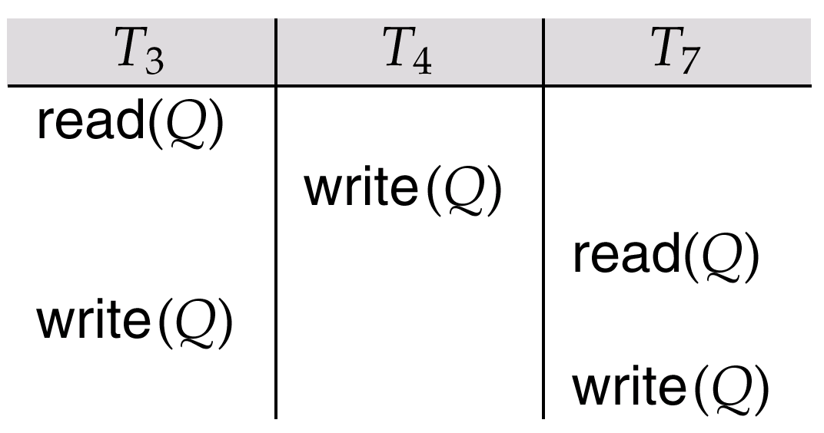
fig. 15.21

Slide 39
Concurrency ControlLock-Based Protocols
A lock is a mechanism to control concurrent access to a data item
Data items can be locked in two modes :
1. exclusive (X) mode. Data item can be both read as well as
written. X-lock is requested using lock-X instruction.
2. shared (S) mode. Data item can only be read. S-lock is
requested using lock-S instruction.
Lock requests are made to concurrency-control manager. Transaction can proceed only after request is granted.

Slide 40

Lock-Based Protocols (Cont.)
Lock-compatibility matrix
A transaction may be granted a lock on an item if the requested lock is compatible with locks already held on the item by other transactions
Any number of transactions can hold shared locks on an item, but if any transaction holds an exclusive on the item no other transaction may hold any lock on the item.
If a lock cannot be granted, the requesting transaction is made to wait till all incompatible locks held by other transactions have been released. The lock is then granted.

Slide 41
Lock-Based Protocols (Cont.)
Example of a transaction performing locking:
T₂: lock-S(A);
read (A);
unlock(A);
lock-S(B);
read (B);
unlock(B);
display(A+B)
Locking as above is not sufficient to guarantee serializability — if A and B get updated in-between the read of A and B, the displayed sum would be wrong.
A locking protocol is a set of rules followed by all transactions while requesting and releasing locks. Locking protocols restrict the set of possible schedules.

Slide 42

Pitfalls of Lock-Based Protocols
Consider the partial schedule
Neither T₃ nor T₄ can make progress — executing lock-S(B) causes T₄ to wait for T₃ to release its lock on B, while executing lock-X(A) causes T₃ to wait for T₄ to release its lock on A.
Such a situation is called a deadlock.
  To handle a deadlock one of T₃ or T₄ must be rolled back
  and its locks released.

Slide 43
Pitfalls of Lock-Based Protocols (Cont.)
The potential for deadlock exists in most locking protocols. Deadlocks are a necessary evil.
Starvation is also possible if concurrency control manager is badly designed. For example:
  A transaction may be waiting for an X-lock on an item, while a sequence of other transactions request and are granted an S-lock on the same item.
  The same transaction is repeatedly rolled back due to deadlocks.
Concurrency control manager can be designed to prevent starvation.

Slide 44
Timestamp-Based Protocols
Each transaction is issued a timestamp when it enters the system. If an old transaction T_{i} has time-stamp TS(T_{i}), a new transaction T_{j} is assigned time-stamp TS(T_{j}) such that TS(T_{i}) <TS(T_{j}).
The protocol manages concurrent execution such that the time-stamps determine the serializability order.
In order to assure such behavior, the protocol maintains for each data Q two timestamp values:
  W-timestamp(Q) is the largest time-stamp of any transaction that executed write(Q) successfully.
  R-timestamp(Q) is the largest time-stamp of any transaction that executed read(Q) successfully.

Slide 45
Deadlock Handling
Consider the following two transactions:
T₁: write (X) T₂: write(Y)
write(Y) write(X)
Schedule with deadlock
T₁
T₂
lock-X on X
write (X)
lock-X on Y
write (X)
wait for lock-X on X
wait for lock-X on Y

Slide 46
Deadlock Handling
System is deadlocked if there is a set of transactions such that every transaction in the set is waiting for another transaction in the set.
Deadlock prevention protocols ensure that the system will never enter into a deadlock state. Some prevention strategies :
  Require that each transaction locks all its data items before it begins execution (predeclaration).
  Impose partial ordering of all data items and require that a transaction can lock data items only in the order specified by the partial order (graph-based protocol).

Slide 47
More Deadlock Prevention Strategies
Following schemes use transaction timestamps for the sake of deadlock prevention alone.
wait-die scheme — non-preemptive
  older transaction may wait for younger one to release data item. Younger transactions never wait for older ones; they are rolled back instead.
  a transaction may die several times before acquiring needed data item
wound-wait scheme — preemptive
  older transaction wounds (forces rollback) of younger transaction instead of waiting for it. Younger transactions may wait for older ones.
  may be fewer rollbacks than wait-die scheme.

Slide 48


Deadlock Detection (Cont.)
Wait-for graph without a cycle
Wait-for graph with a cycle

Slide 49
Deadlock Recovery
When deadlock is detected :
  Some transaction will have to rolled back (made a victim) to break deadlock. Select that transaction as victim that will incur minimum cost.
  Rollback -- determine how far to roll back transaction
    Total rollback: Abort the transaction and then restart it.
    More effective to roll back transaction only as far as necessary to break deadlock.
  Starvation happens if same transaction is always chosen as victim. Include the number of rollbacks in the cost factor to avoid starvation

Slide 50
End of Chapter

Slide 51

Partial Schedule Under Two-Phase Locking

Slide 52

Incomplete Schedule With a Lock Conversion

Slide 53
Lock Table

Slide 54
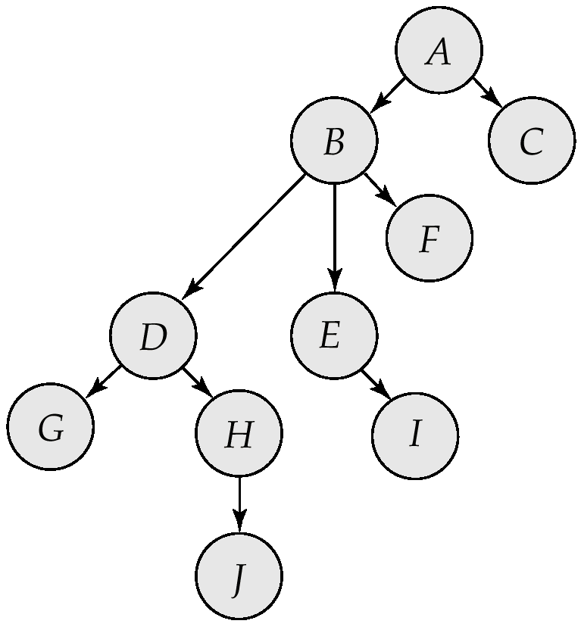
Tree-Structured Database Graph

Slide 55
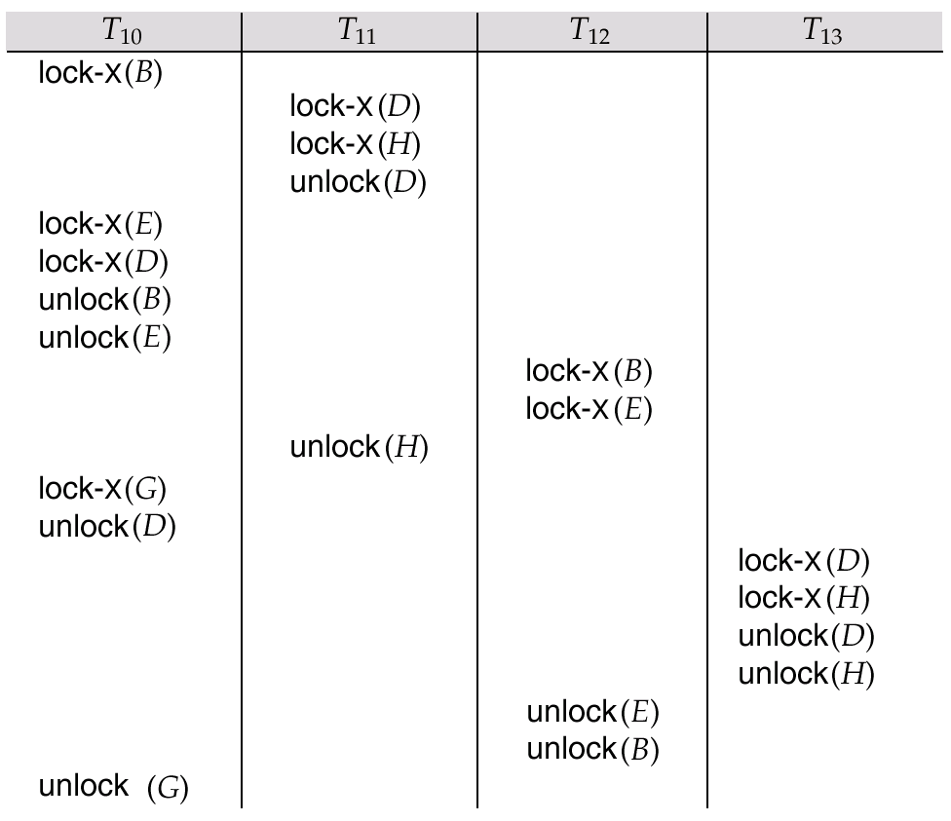
Serializable Schedule Under the Tree Protocol

Slide 56
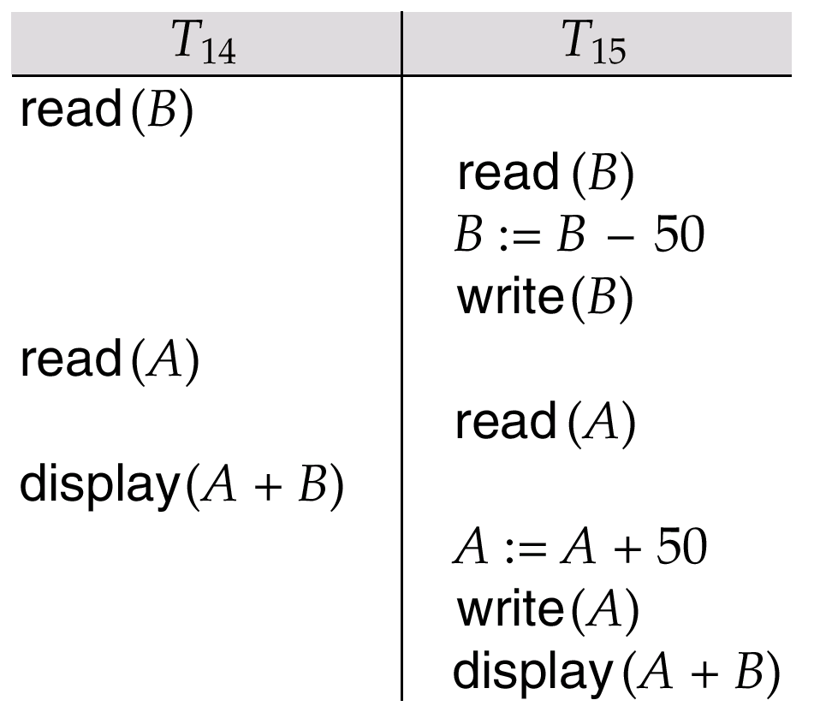
Schedule 3

Slide 57
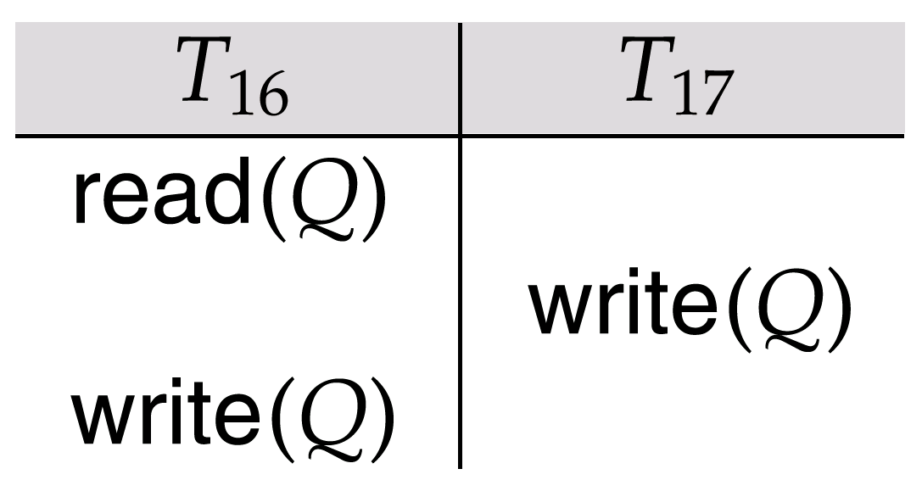
Schedule 4

Slide 58
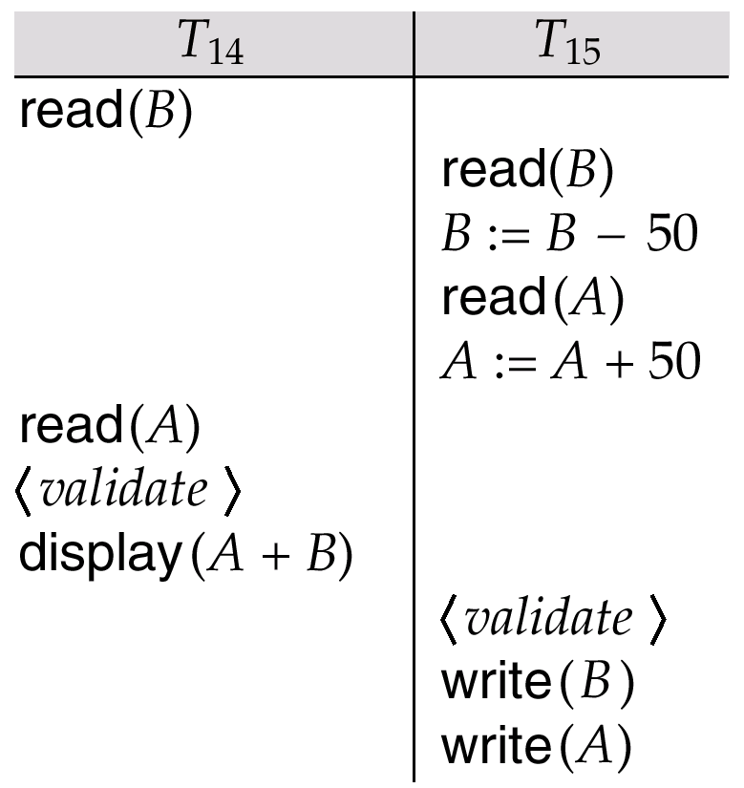
Schedule 5, A Schedule Produced by Using Validation

Slide 59

Granularity Hierarchy

Slide 60
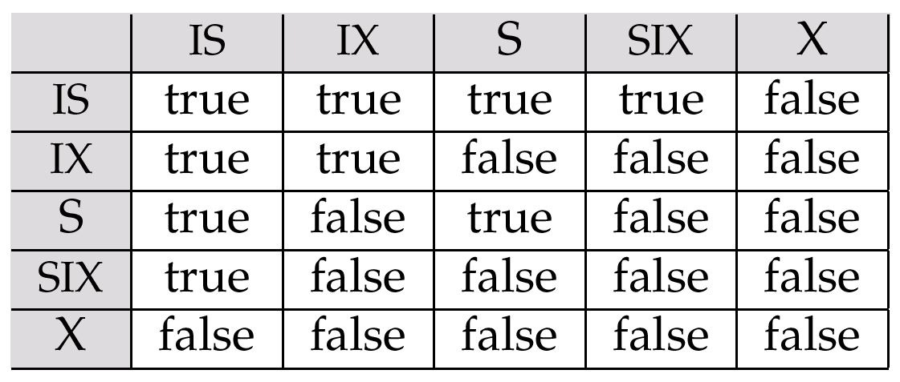
Compatibility Matrix

Slide 61
Wait-for Graph With No Cycle

Slide 62
Wait-for-graph With A Cycle

Slide 63
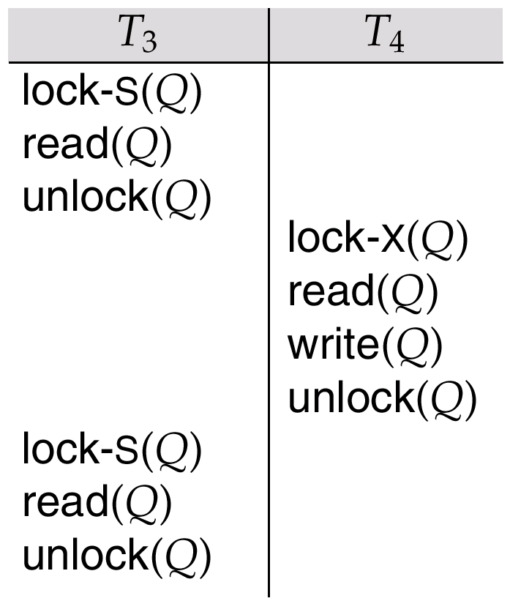
Nonserializable Schedule with Degree-Two Consistency

Slide 64
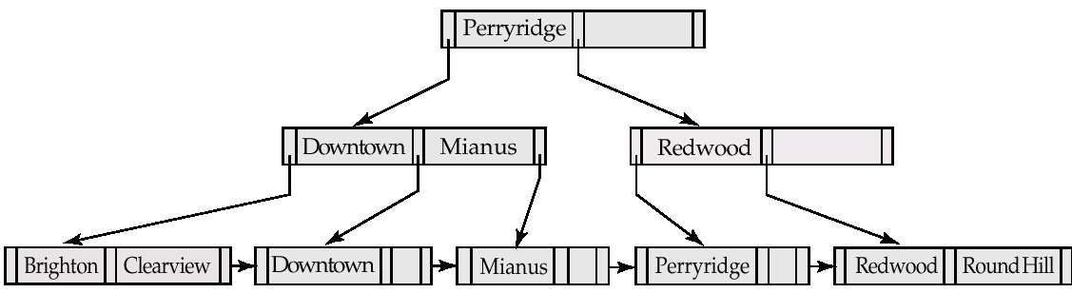
B⁺-Tree For account File with n = 3.

Slide 65
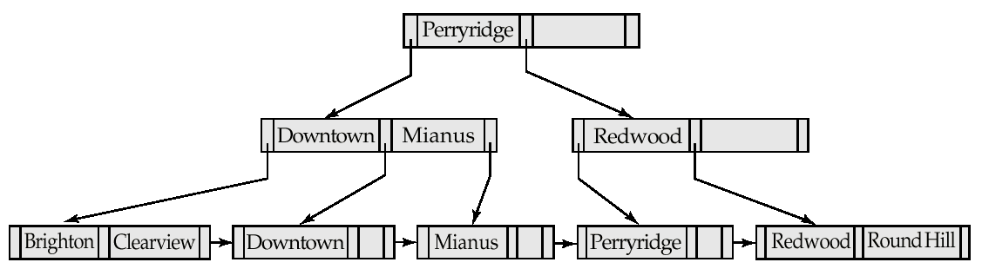
Insertion of “Clearview” Into the B⁺-Tree of Figure 16.21

Slide 66
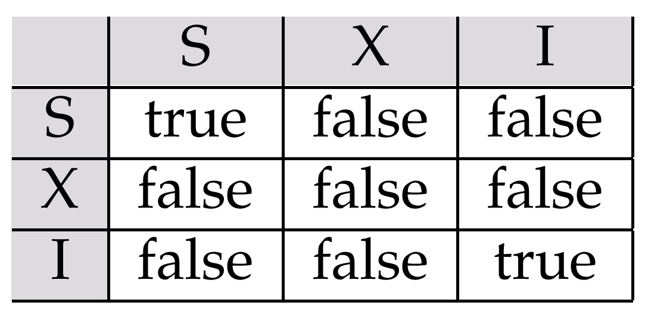
Lock-Compatibility Matrix

